Slide 1
Inheritance with Java Interfaces

Slide 2

Objectives
After completing this lesson, you should be able to do the following:
  Model business problems by using interfaces
  Define a Java interface
  Choose between interface inheritance and class inheritance
  Extend an interface
  Refactor code to implement the DAO pattern
Notes:
Java SE 7 Programming 6 - <number>

Slide 3
Implementation Substitution
The ability to outline abstract types is a powerful feature of Java. Abstraction enables:
  Ease of maintenance
    Classes with logic errors can be substituted with new and improved classes.
  Implementation substitution
    The java.sql package outlines the methods used by developers to communicate with databases, but the implementation is vendor-specific.
  Division of labor
    Outlining the business API needed by an application’s UI allows the UI and the business logic to be developed in tandem.
Notes:
Abstraction
You just learned how to define abstract types by using classes. There are two ways to define type abstraction in Java: abstract classes and interfaces. By writing code to reference abstract types, you no longer depend on specific implementing classes. Defining these abstract types may seem like extra work in the beginning but can reduce refactoring at a later time if used appropriately.
Java SE 7 Programming 6 - <number>

Slide 4
Java Interfaces
Java interfaces are used to define abstract types. Interfaces:
  Are similar to abstract classes containing only public abstract methods
  Outline methods that must be implemented by a class
    Methods must not have an implementation {braces}.
  Can contain constant fields
  Can be used as a reference type
  Are an essential component of many design patterns
Notes:
In Java, an interface outlines a contract for a class. The contract outlined by an interface mandates the methods that must be implemented in a class. Classes implementing the contract must fulfill the entire contract or be declared abstract.
Java SE 7 Programming 6 - <number>

Slide 5
Developing Java Interfaces
Public, top-level interfaces are declared in their own .java file. You implement interfaces instead of extending them.
  public interface ElectronicDevice {
  public void turnOn();
  public void turnOff();
  }
  public class Television implements ElectronicDevice {
  public void turnOn() { }
  public void turnOff() { }
  public void changeChannel(int channel) {}
  private void initializeScreen() {}
  }
Notes:
Rules for Interfaces
Access Modifiers
All methods in an interface are public, even if you forget to declare them as public. You may not declare methods as private or protected in an interface. The contract that an interface outlines is a public API that must be provided by a class.
Abstract Modifier
Because all methods are implicitly abstract, it is redundant (but allowed) to declare a method abstract. Because all interface methods are abstract, you may not provide any method implementation, not even an empty set of braces.
Implements and Extends
A class can extend one parent class and then implement a comma-separated list of interfaces.
Java SE 7 Programming 6 - <number>

Slide 6
Constant Fields
Interfaces can have constant fields.
  public interface ElectronicDevice {
  public static final String WARNING =
  "Do not open, shock hazard";
  public void turnOn();
  public void turnOff();
  }
Notes:
Only constant fields are permitted in an interface. When you declare a field in an interface, it is implicitly public, static, and final. You may redundantly specify these modifiers. Avoid grouping all the constant values for an application in a single interface; good design distributes the constant values of an application across many classes and interfaces. Creating monolithic classes or interfaces that contain large groupings of unrelated code does not follow best practices for object-oriented design.
Java SE 7 Programming 6 - <number>

Slide 7
Interface References
You can use an interface as a reference type. When using an interface reference type, you must use only the methods outlined in the interface.
ElectronicDevice ed = new Television();
ed.turnOn();
ed.turnOff();
ed.changeChannel(2); // fails to compile
String s = ed.toString();
Notes:
An interface-typed reference can be used only to reference an object that implements that interface. If an object has all the methods outlined in the interface but does not implement the interface, you may not use the interface as a reference type for that object. Interfaces implicitly include all the methods from java.lang.Object.
Java SE 7 Programming 6 - <number>

Slide 8
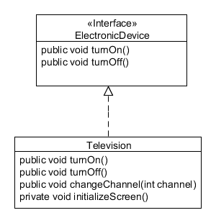
instanceof Operator
You can use instanceof with interfaces.
Television t = new Television();
if (t instanceof ElectronicDevice) { }
Implements
Television is an instance of an ElectronicDevice.
Notes:
Previously, you used instanceof on class types. Any type that can be used as a reference can be used as an operand for the instanceof operator. In the slide, a Television implements ElectronicDevice . Therefore, a Television is an instance of a Television, an ElectronicDevice, and a java.lang.Object.
Java SE 7 Programming 6 - <number>

Slide 9
Marker Interfaces
  Marker interfaces define a type but do not outline any methods that must be implemented by a class.
public class Person implements java.io.Serializable { }
  The only reason these type of interfaces exist is type checking.
  Person p = new Person();
  if (p instanceof Serializable) {
  }
Notes:
java.io.Serializable is a marker interface used by Java's I/O library to determine if an object can have its state serialized. When implementing Serializable, you are not required to provide method implementations. Testing (in the form of the instanceof operator) for the serializability of an object is built into the standard I/O libraries. You use this interface in the lesson titled “Java I/O Fundamentals.”
Java SE 7 Programming 6 - <number>

Slide 10
Casting to Interface Types
You can cast to an interface type.
public static void turnObjectOn(Object o) {
if (o instanceof ElectronicDevice) {
ElectronicDevice e = (ElectronicDevice)o;
e.turnOn();
}
}
Notes:
Casting Guidelines
Just as you do when casting to class types, if you cast to a type that is invalid for that object, your application generates an exception and is even likely to crash. To verify that a cast will succeed, you should use an instanceof test.
The example in the slide shows poor design because the turnObjectOn() method operates only on ElectronicDevices. Using instanceof and casting adds overhead at run time. When possible, use a compile-time test by rewriting the method as:
public static void turnObjectOn(ElectronicDevice e) {
e.turnOn();
}
Java SE 7 Programming 6 - <number>

Slide 11
Using Generic Reference Types
  Use the most generic type of reference wherever possible:
EmployeeDAO dao = new EmployeeDAOMemoryImpl();
dao.delete(1);
  By using an interface reference type, you can use a different implementing class without running the risk of breaking subsequent lines of code:
EmployeeDAOMemoryImpl dao = new EmployeeDAOMemoryImpl(); dao.delete(1);
EmployeeDAOMemoryImpl implements EmployeeDAO
It is possible that you could be using EmployeeDAOMemoryImpl only methods here.
Notes:
When creating references, you should use the most generic type possible. This means that, for the object you are instantiating, you should declare the reference to be of an interface type or of a parent class type. By doing this, all usage of the reference is not tied to a particular implementing class and, if need be, you could use a different implementing class. By using an interface that several classes implement as the reference type, you have the freedom to change the implementation without affecting your code. An EmployeeDAOMemoryImpl typed reference could be used to invoke a method that appears only in the EmployeeDAOMemoryImpl class.
References typed to a specific class cause your code to be more tightly coupled to that class and potentially cause greater refactoring of your code when changing implementations.
Java SE 7 Programming 6 - <number>

Slide 12
Implementing and Extending
  Classes can extend a parent class and implement an interface:
public class AmphibiousCar extends BasicCar implements MotorizedBoat { }
  You can also implement multiple interfaces:
public class AmphibiousCar extends BasicCar implements MotorizedBoat, java.io.Serializable { }
Use a comma to separate your list of interfaces.
Notes:
Extends First
If you use both extends and implements, extends must come first.
Java SE 7 Programming 6 - <number>

Slide 13
Extending Interfaces
  Interfaces can extend interfaces:
public interface Boat { }
public interface MotorizedBoat extends Boat { }
  By implementing MotorizedBoat, the AmphibiousCar class must fulfill the contract outlined by both MotorizedBoat and Boat:
public class AmphibiousCar extends BasicCar implements MotorizedBoat, java.io.Serializable { }
Notes:
Java SE 7 Programming 6 - <number>

Slide 14
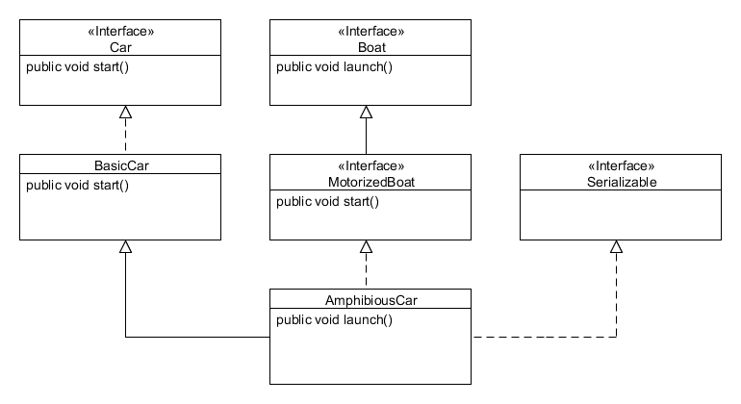
Interfaces in Inheritance Hierarchies
Extends
Implements
Notes:
Interface Inheritances
Interfaces are used for a form of inheritance that is referred to as interface inheritance. Java allows multiple interface inheritance but only single class inheritance.
Extending an Implementing Class
If you write a class that extends a class that implements an interface, the class you authored also implements the interface. For example, AmphibiousCar extends BasicCar. BasicCar implements Car; therefore, AmphibiousCar also implements Car.
Interfaces Extending Interfaces
An interface can extend another interface. For example, the interface MotorizedBoat can extend the Boat interface. If the AmphibiousCar class implements MotorizedBoat, then it must implement all methods from Boat and MotorizedBoat.
Duplicate Methods
When you have a class that implements multiple interfaces, directly or indirectly, the same method signature may appear in different implemented interfaces. If the signatures are the same, there is no conflict and only one implementation is required.
Java SE 7 Programming 6 - <number>

Slide 15
Quiz
A class can implement multiple interfaces.
  True
  False
Notes:
Answer: a
Java SE 7 Programming 6 - <number>

Slide 16
Design Patterns and Interfaces
  One of the principles of object-oriented design is to:
      “Program to an interface, not an implementation.”
  This is a common theme in many design patterns. This principle plays a role in:
    The DAO design pattern
    The Factory design pattern
Notes:
Object-Oriented Design Principles
“Program to an interface, not an implementation” is a practice that was popularized in the book Design Patterns: Elements of Reusable Object-Oriented Software.
You can learn more about object-oriented design principles and design patterns in the Java Design Patterns course.
Java SE 7 Programming 6 - <number>

Slide 17
DAO Pattern
The Data Access Object (DAO) pattern is used when creating an application that must persist information. The DAO pattern:
  Separates the problem domain from the persistence mechanism
  Uses an interface to define the methods used for persistence. An interface allows the persistence implementation to be replaced with:
    Memory-based DAOs as a temporary solution
    File-based DAOs for an initial release
    JDBC-based DAOs to support database persistence
    Java Persistence API (JPA)–based DAOs to support database persistence
Notes:
Why Separate Business and Persistence Code?
Just as the required functionality of an application will influence the design of your classes, so will other concerns. A desire for ease of maintenance and for the ability to enhance an application also influences its design. Modular code that is separated by functionality is easier to update and maintain.
By separating business and persistence logic, applications become easier to implement and maintain at the expense of additional classes and interfaces. Often these two types of logic have different maintenance cycles. For example, the persistence logic might need to be modified if the database used by the application was migrated from MySQL to Oracle 11g.
If you create interfaces for the classes containing the persistence logic, it becomes easier for you to replace your persistence implementation.
Java SE 7 Programming 6 - <number>

Slide 18
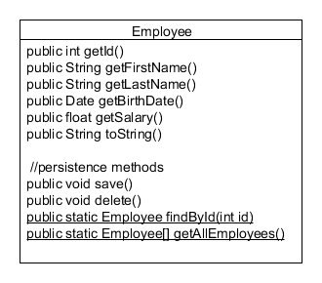
Before the DAO Pattern
Notice the persistence methods mixed in with the business methods.
Before the DAO pattern
Notes:
The Single-Responsibility Principle
The Employee class shown in the slide has methods that focus on two different principles or concerns. One set of methods focuses on manipulating the representation of a person, and the other deals with persisting Employee objects. Because these two sets of responsibilities may be modified at different points in the lifetime of your applications, it makes sense to split them up into different classes.
Java SE 7 Programming 6 - <number>

Slide 19
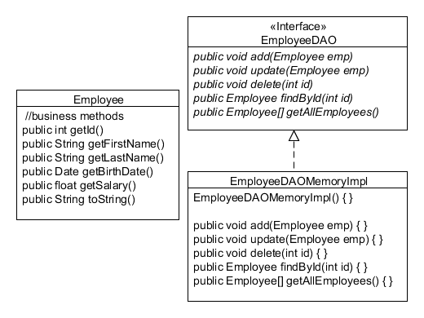
After the DAO Pattern
The DAO pattern moves the persistence logic out of the domain classes and into separate classes.
After refactoring to the DAO pattern
Notes:
DAO Implementations
If you think that you might need to change your DAO implementation at a later time to use a different persistence mechanism, it is best to use an interface to define the contract that all DAO implementations must meet.
Your DAO interfaces outline methods to create, read, update, and delete data, although the method names can vary. When you first implement the DAO pattern, you will not see the benefit immediately. The payoff comes later, when you start modifying or replacing code. In the lesson titled “Building Database Applications with JDBC,” we discuss replacing the memory-based DAO with file- and database-enabled DAOs.
Java SE 7 Programming 6 - <number>

Slide 20
The Need for the Factory Pattern
The DAO pattern depends on using interfaces to define an abstraction. Using a DAO implementation’s constructor ties you to a specific implementation.
  EmployeeDAO dao = new EmployeeDAOMemoryImpl();
With use of an interface type, any subsequent lines are not tied to a single implementation.
This constructor invocation is tied to an implementation and will appear in many places throughout an application.
Notes:
Java SE 7 Programming 6 - <number>

Slide 21
Using the Factory Pattern
Using a factory prevents your application from being tightly coupled to a specific DAO implementation.
  EmployeeDAOFactory factory = new EmployeeDAOFactory();
  EmployeeDAO dao = factory.createEmployeeDAO();
The EmployeeDAO implementation is hidden.
Notes:
This pattern eliminates direct constructor calls in favor of invoking a method. A factory is often used when implementing the DAO pattern.
In the example in the slide, you have no idea what type of persistence mechanism is used by EmployeeDAO because it is just an interface. The factory could return a DAO implementation that uses files or a database to store and retrieve data. As a developer, you want to know what type of persistence is being used because it factors into the performance and reliability of your application. But you do not want the majority of the code you write to be tightly coupled with the type of persistence.
Java SE 7 Programming 6 - <number>

Slide 22
The Factory
  The implementation of the factory is the only point in the
  application that should depend on concrete DAO classes.
  public class EmployeeDAOFactory {
  public EmployeeDAO createEmployeeDAO() {
  return new EmployeeDAOMemoryImpl();
  }
  }
Returns an interface typed reference
Notes:
For simplicity, this factory hardcodes the name of a concrete class to instantiate. You could enhance this factory by putting the class name in an external source such as a text file and use the java.lang.Class class to instantiate the concrete subclass. A basic example of using the java.lang.Class is the following:
String name = "com.example.dao.EmployeeDAOMemoryImpl";
Class clazz = Class.forName(name);
EmployeDAO dao = (EmployeeDAO)clazz.newInstance();
Java SE 7 Programming 6 - <number>

Slide 23
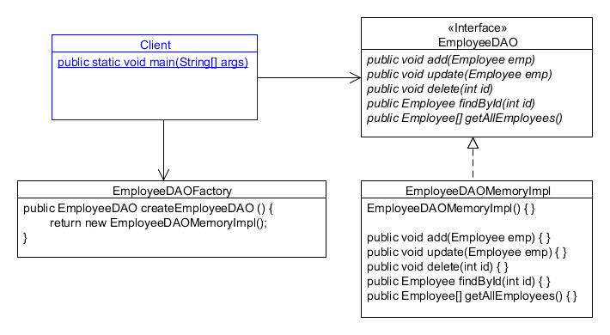
The DAO and Factory Together
Clients depending only on abstract DAOs
Notes:
Java SE 7 Programming 6 - <number>

Slide 24
Quiz
A typical singleton implementation contains a factory method.
  True
  False
Notes:
Answer: a
Java SE 7 Programming 6 - <number>

Slide 25
Code Reuse
Code duplication (copy and paste) can lead to maintenance problems. You do not want to fix the same bug multiple times.
  “Don’t repeat yourself!” (DRY principle)
  Reuse code in a good way:
    Refactor commonly used routines into libraries.
    Move the behavior shared by sibling classes into their parent class.
    Create new combinations of behaviors by combining multiple types of objects together (composition).
Notes:
Copying and pasting code is not something that must always be avoided. If duplicated code serves as a starting point and is heavily modified, that may be an acceptable situation for you to copy and paste lines of code. You should be aware of how much copying and pasting is occurring in a project. Besides performing manual code audits, there are tools you can use to detect duplicated code. For one such example, refer to http://pmd.sourceforge.net/cpd.html.
Java SE 7 Programming 6 - <number>

Slide 26
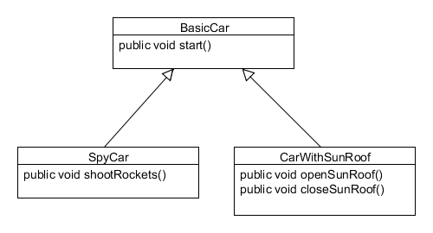
Design Difficulties
Class inheritance allows for code reuse but is not very modular
  How do you create a SpyCarWithSunRoof?
Method implementations located across different classes
Notes:
Limitations with Inheritance
Java supports only single class inheritance, which eliminates the possibility of inheriting different implementations of a method with the same signature. Multiple interface inheritance does not pose the same problem as class inheritance because there can be no conflicting method implementations in interfaces.
Java SE 7 Programming 6 - <number>

Slide 27
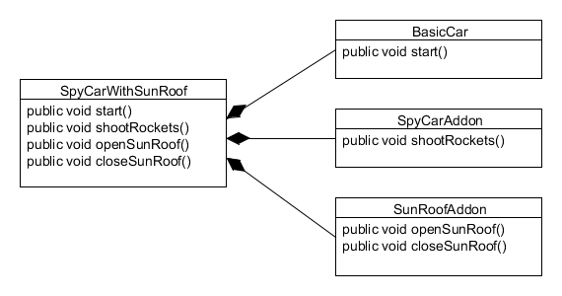
Composition
Object composition allows you to create more complex objects. To implement composition, you:
  Create a class with references to other classes.
  Add same signature methods that forward to the referenced objects.
composition
Combining multiple classes' methods
through composition and forwarding
Notes:
Delegation
Method delegation and method forwarding are two terms that are often used interchangeably. Method forwarding is when you write a method that does nothing except pass execution over to another method. In some cases, delegation may imply more than simple forwarding. For more on the difference between the two, refer to page 20 of the book Design Patterns: Elements of Reusable Object-Oriented Software.
Java SE 7 Programming 6 - <number>

Slide 28
Composition Implementation
  public class SpyCarWithSunRoof {
  private BasicCar car = new BasicCar();
  private SpyCarAddon spyAddon = new SpyCarAddon();
  private SunRoofAddon roofAddon = new SunRoofAddon();
  public void start() {
  car.start();
  }
  // other forwarded methods
  }
Method forwarding
Notes:
IDE Wizards Make Implementing Composition Easy
To implement composition with the NetBeans IDE, use the Insert Code tool as follows:
1. Right-click within the braces of the complex class and choose "Insert Code.”
2. Select "Delegate Method.”
The Generate Delegate Methods dialog box appears.
3. Select the method calls that you want to forward.
The methods are inserted for you.
Repeat these steps for each delegate class.
Java SE 7 Programming 6 - <number>

Slide 29
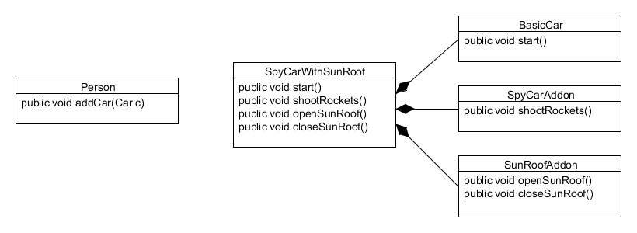
Polymorphism and Composition
Polymorphism should enable us to pass any type of Car to the addCar method. Composition does not enable polymorphism unless…
A complex car object that cannot be passed to a method expecting a simple car
Notes:
Code Reuse
The ability to use the addCar method for any type of Car, no matter how complex, is another form of code reuse. We cannot currently say the following:
addCar(new SpyCarWithSunRoof());
Java SE 7 Programming 6 - <number>

Slide 30
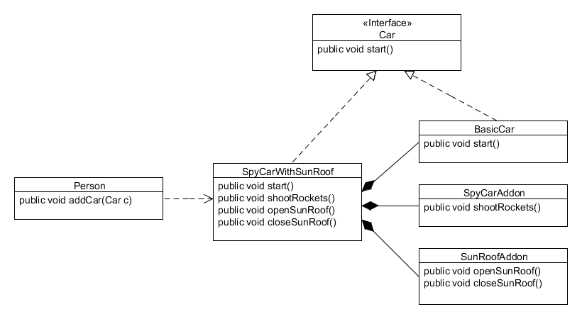
Polymorphism and Composition
Use interfaces for all delegate classes to support polymorphism.
Composition with interfaces to support polymorphism
Notes:
Each delegate class that you use in a composition should have an interface defined. When creating the composing class, you declare that it implements all of the delegate interface types.
By doing this, you create an object that is a composition of other objects and has many types.
Now we can say:
addCar(new SpyCarWithSunRoof());
Java SE 7 Programming 6 - <number>

Slide 31
Quiz
Method delegation is required to create complex objects using:
  Polymorphism
  Composition
Notes:
Answer: b
Java SE 7 Programming 6 - <number>

Slide 32

Summary
In this lesson, you should have learned how to:
  Model business problems by using interfaces
  Define a Java interface
  Choose between interface inheritance and class inheritance
  Extend an interface
  Refactor code to implement the DAO pattern
Notes:
Java SE 7 Programming 6 - <number>

Slide 33

Practice 6-1 Overview:
Implementing an Interface
This practice covers the following topics:
  Writing an interface
  Implementing an interface
  Creating references of an interface type
  Casting to interface types
Notes:
Java SE 7 Programming 6 - <number>

Slide 34
Practice 6-2 Overview:
Applying the DAO Pattern
This practice covers the following topics:
  Rewriting an existing domain object with a memory-based persistence implementation using the DAO pattern
  Leveraging an abstract factory to avoid depending on concrete implementations
Notes:
Java SE 7 Programming 6 - <number>

Slide 35
(Optional) Practice 6-3 Overview:
Implementing Composition
This practice covers the following topics:
  Rewriting an existing application to better support code reuse through composition
  Using interfaces to enable polymorphism
Notes:
Java SE 7 Programming 6 - <number>

